Slide 1
Last Week’s Quiz

Slide 2
Last Week’s Assignment

Slide 3
Lecture 8
Trees (Continued)

Slide 4
BST Height and Insertion Order Recap
A tree’s height is the maximum edges from the root to any leaf
The minimum n-node binary tree height is h = log(n)
The maximum n-node binary tree height is n - 1

Slide 5
BST Height and Insertion Order Recap
Searching a BST is fast if the tree’s height is near the minimum
Inserting items in random order naturally keeps a BST’s height near the minimum
Inserting items in nearly-sorted order leads to a nearly-maximum tree height

Slide 6
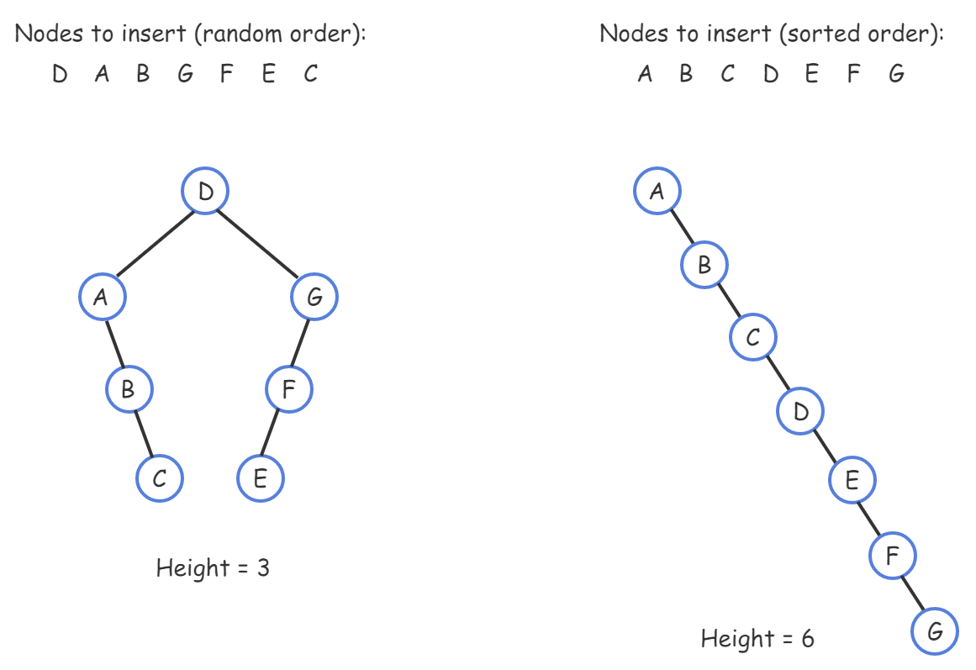
BST Height

Slide 7
AVL Tree
Named after inventors Adelson-Velsky and Landis
An AVL tree is a BST with a height balance property and specific operations to rebalance the tree when a node is inserted or removed
A BST is height balanced if for any node, the heights of the node’s left and right subtrees differ by only 0 or 1
A node’s balance factor is the left subtree height minus the right subtree height
Which is 1, 0, or -1 in an AVL tree

Slide 8
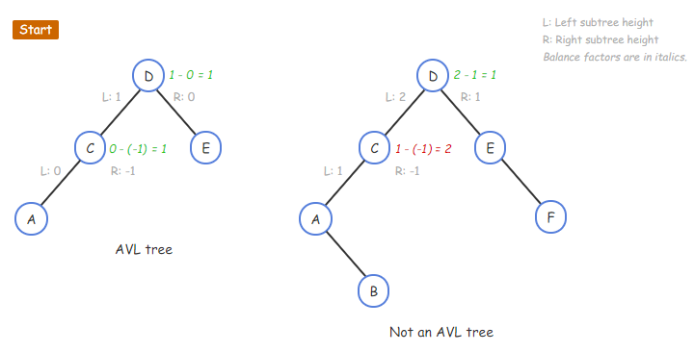
AVL Tree
*We are interested in the height of the subtree of each node

Slide 9
AVL Insertions
Inserting an item into an AVL tree may cause the tree to become unbalanced
A rotation can rebalance the tree
A rotation is a local rearrangement of a BST that maintains the BST ordering property while rebalancing the tree
Sometimes, the imbalance is due to an insertion on the inside of a subtree, rather than on the outside
One rotation won’t rebalance, a double rotation is needed

Slide 10
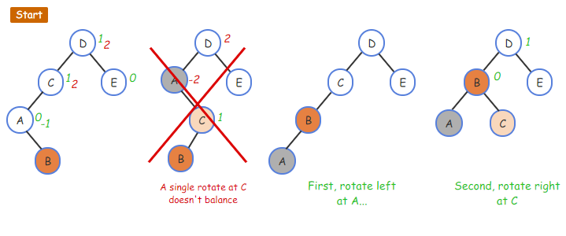
AVL Double Rotation
The green and red numbers are the balance factor before and after adding new node

Slide 11
AVL Insertions
After inserting a node, nodes on the path from the new node to the root should be checked for a balance factor of 2 or -2
The first such node p triggers rebalancing
Four cases exist, distinguishable by the balance factor of node p and a child

Slide 12
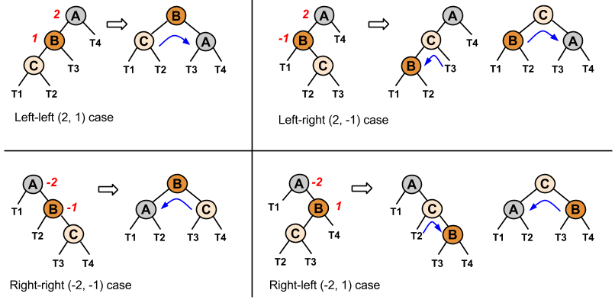
AVL Rotation Cases

Slide 13
AVL Insertions
An AVL tree insertion involves the following steps:
Search for the insert location
Insert the new node
Update the balance factors
Rebalance
Balance factor updates are only needed on nodes ascending along the path from the inserted node up to the root

Slide 14
AVL Insertions
Each node’s balance factor can be recomputed by determining left and right subtree heights
Or for speed, can be stored in each node and then incrementally updated
+1 if ascending from a left child
-1 if ascending from a right child
If a balance factor update yields 2 or -2, the imbalance case is determined via that node’s left (2) or right (-2) child’s balance factor
Then the appropriate rotations are performed

Slide 15
Perfectly Balanced Tree
A perfectly balanced tree requires all levels be full except the last level
This results in minimum height and fastest search
If nodes are inserted and removed dynamically, maintaining a perfectly balanced tree requires extensive tree rearrangements
An AVL tree however, only requires a few local rotations so is more computationally efficient but it DOES NOT guarantee minimum possible height

Slide 16
AVL Tree Height
An AVL tree’s worst case height is at worse about 1.5x the minimum binary tree height
The height is still O(log(n)) where n is the number of nodes
In practice, AVL tree heights are much closer to the minimum

Slide 17
Java Implementation Example
https://www.geeksforgeeks.org/avl-tree-set-1-insertion/

Slide 18
Heaps
Some applications require fast access to and removal of the maximum item in a changing set of items
Example:
A list of computer jobs (ranked by priority) waiting for completion
Maintaining jobs in fully-sorted order requires more operations than necessary, since only the maximum item is needed

Slide 19
Max-Heap
A max-heap is a binary tree that maintains the simple property that a node’s key is greater than or equal to all the node’s children's keys
Therefore, a max-heap’s root always has the maximum key in the entire tree

Slide 20
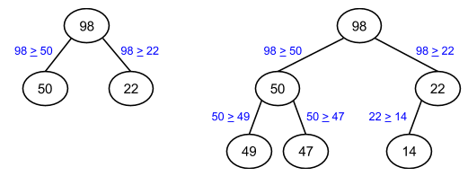
Max-Heap

Slide 21
Insert into Max-Heap
An insert into a max-heap starts by inserting the node in the tree’s last level and then swapping the node with its parent until no max-heap property violation occurs
Inserts fill a level (left-to-right) before adding another level so the tree’s height is always the min possible
The upward movement of a node in a max-heap is sometimes called percolating

Slide 22
Remove from Max-Heap
A remove from a max-heap is always a removal of the root
Completed by replacing the root with the last level’s last node and swapping that node with its greatest child until no max-heap property violation occurs

Slide 23
Min-Heap
A min-heap is similar to a max-heap, but a node’s key is less than or equal to its children’s keys

Slide 24
Treaps
A BST built from inserts of n nodes having random-ordered keys stays well-balanced and thus has near-minimum height
Searches, inserts, and deletes are O(log(n))
Because insertion order may not be controllable, a data structure that somehow randomizes BST insertions is desirable
Uses a main key that maintains a binary search tree ordering property and a second key generated randomly (called “priority”) during insertions that maintains a heap property

Slide 25
Treap
The combination of these keys usually keeps the tree balanced
The word “treap” is a mix of tree and heap
A treap search is the same as a BST search using the main key, since the treap is a BST
A treap delete can be done by setting the node’s priority such that the node should be a leaf, percolating the node down using rotations until the node is a leaf and then removing the node

Slide 26
Treap Insert
A treap insert includes the following actions:
Inserts a node as in a BST using the main key
Then assigns a random priority to the node
Percolates the node up until the heap property is not violated
In a heap, a node is moved up via a swap with the node’s parent
In a treap, a node is moved up via a rotation at the parent
Unlike a swap, a rotation maintains the BST property

Slide 27
Treap Delete
Set the node’s priority to negative infinity (for a max-heap)
Percolate the node down until it is a leaf and then remove it
Percolating the node down uses rotations, not swaps, to maintain the BST property
The node is rotated in the direction of the lower-priority child so that the node rotated up has a higher priority than that child, to keep the heap property

Slide 28
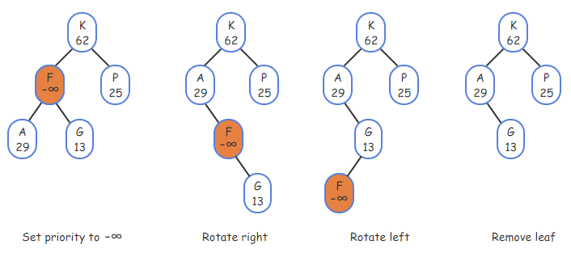
Treap Delete

Slide 29
Quiz This Week
Topic: Balancing Trees

Slide 30
Zybooks
Sections 4.11 - 4.14, 4.19, 4.23

